Slide 1
Day 1: FDP Visual Intelligence: Exploring Image Processing and Computer Vision Topic: Image Segmentation in CV

Slide 2
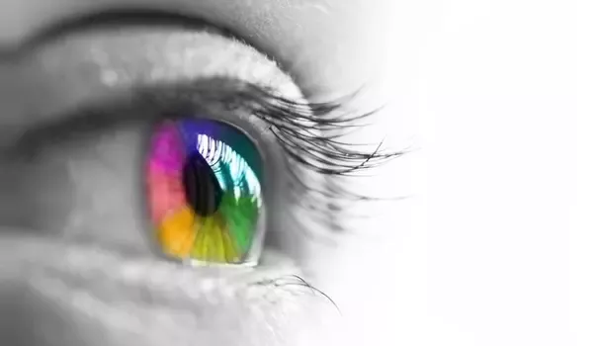
Visual Intelligence: Four A’s
Visual intelligence: The ability to assess, analyze, articulate, and adapt to visual information in one’s environment
Assess your situation. Ask: What do I have in front of me? What data is here?
Analyze the data. Break it down and decide what’s information.
Articulate your observations. Put them into Algorithm.
Adapt to the situation. Take the information from the first three A’s, make a decision, and act on it.

Slide 3

Visual Intelligence: Building blocks
Visual Intelligence
Coding Skilss
Deep Learning
ML
Artificial Intelligence
NN
Computer Vision
Image Processing
Computer Graphics

Slide 4
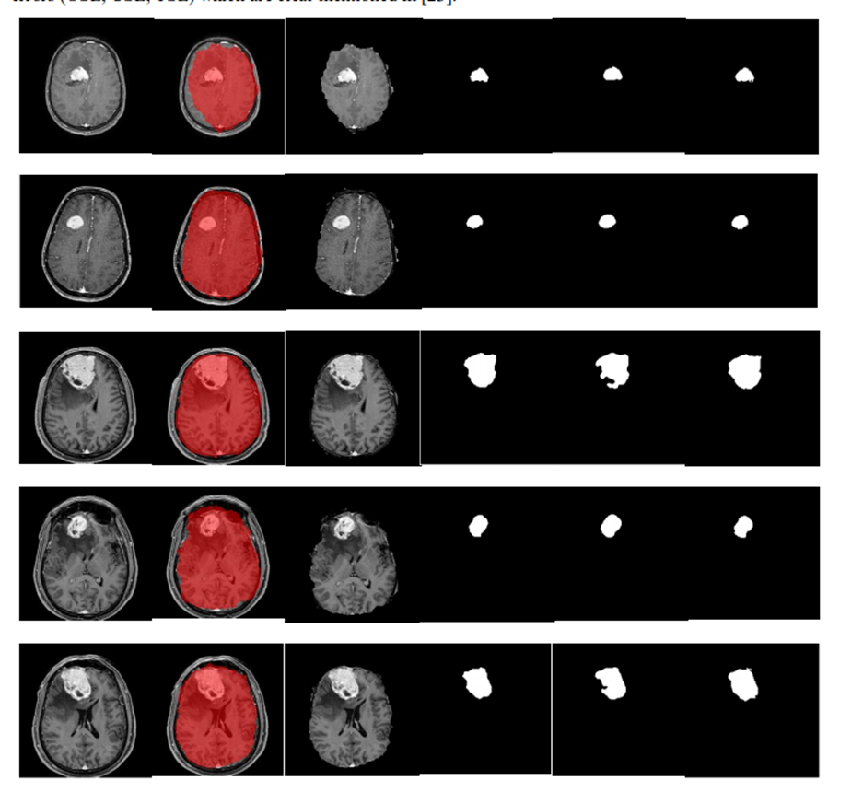
Research Problem statement 1
Design an efficient model to detect a tumour in the brain

Slide 5
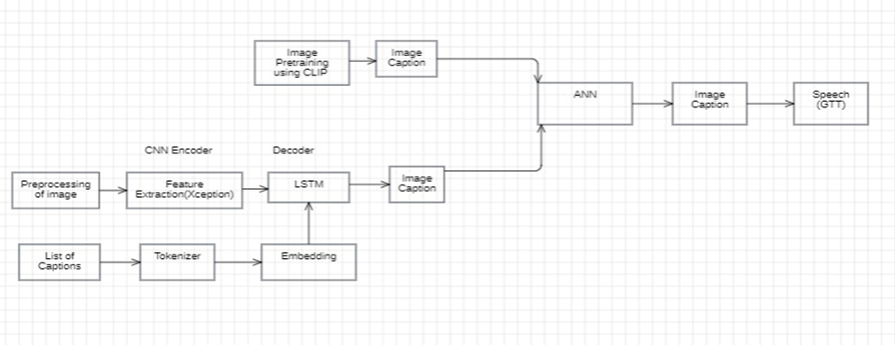
Research Problem statement 2
Design a model to assist in knowing the object for Visually impaired people.

Slide 6
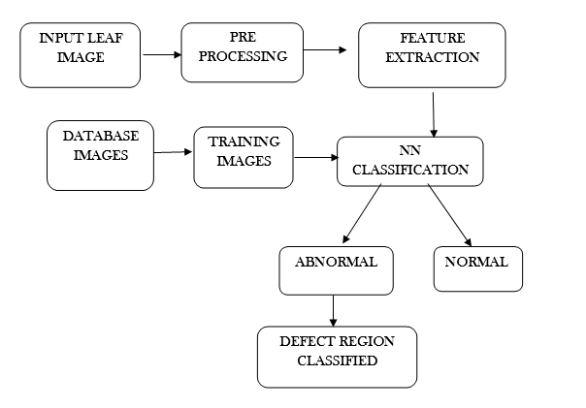
Research Problem Statement 3
Design an efficient model to detect leaf disease detection

Slide 7
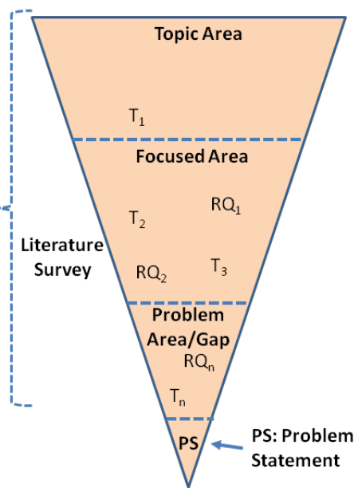
How to Select Research Problem?

Slide 8

Start-----------------Stop???????
Input
Innovative approach
Output

Slide 9
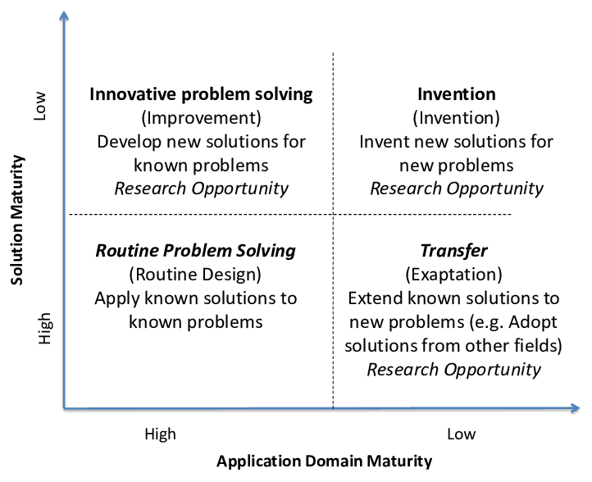
Where are you?

Slide 10
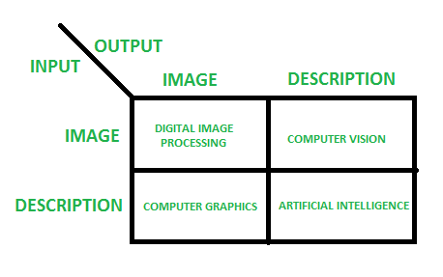
What is Image Segmentation?
Image segmentation is the process of dividing an image into multiple meaningful and homogeneous regions or objects based on their inherent characteristics, such as colour, texture, shape, or brightness.
All the pixels belonging to the same category have a common label assigned to them.

Slide 11
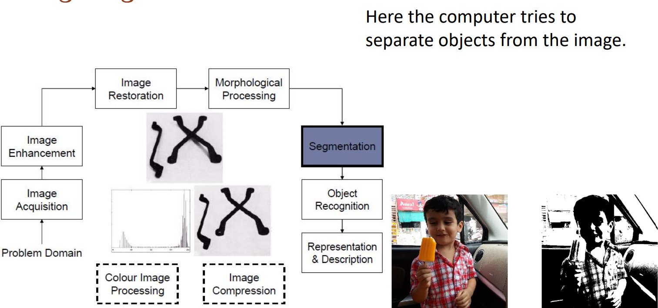
Image processing-Segmentation

Slide 12
What for Image Segmentation?
Object Detection and Recognition
Semantic Understanding
Image Annotation and Labeling
Region-based Image Editing
Medical Imaging
Scene Understanding of Robotics
Video Analysis and Surveillance
Remote Sensing and Geospatial Analysis

Slide 13
Types of Image Segmentation
Instance
Semantic
Panoptic.
Instance segmentation
Involves detecting and segmenting each object in an image
The algorithm has no idea of the class of the region, but it separates overlapping objects.
Instance segmentation is useful in applications where individual objects need to be identified and tracked
Semantic segmentation
Involves labelling each pixel in an image with a corresponding class label with no other information or context taken into consideration.
The algorithm takes an image as input and generates a segmentation map where the pixel value (0,1,...255) of the image is transformed into class labels (0,1,...n). It is useful in applications where identifying the different classes of objects on the road is important.

Slide 14
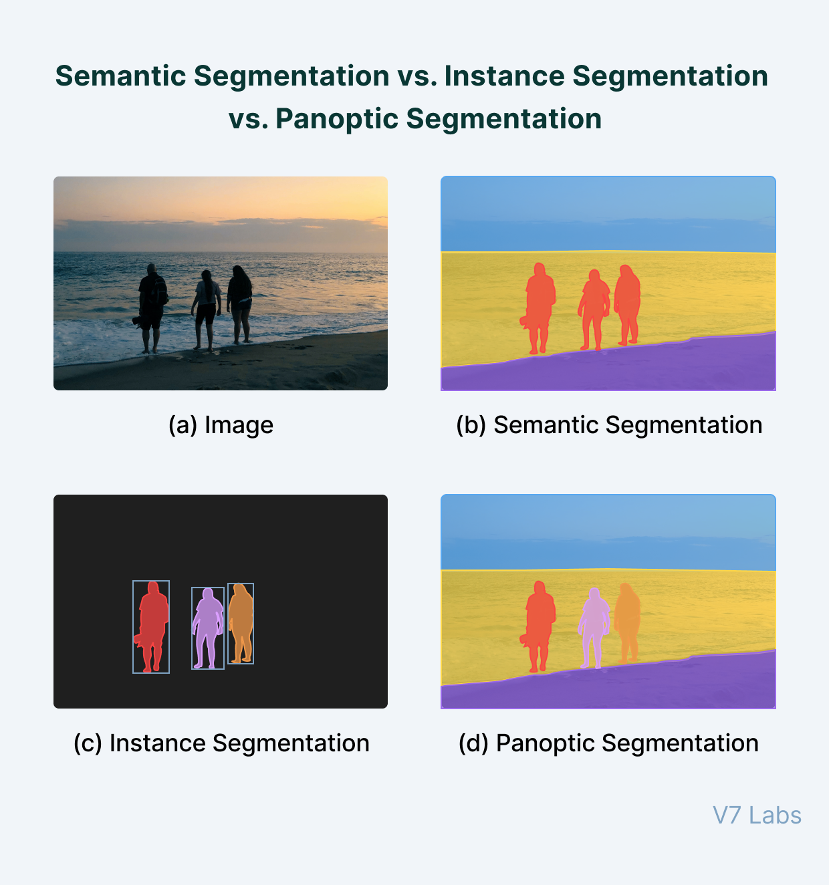
Panoptic segmentation
It is a combination of semantic and instance segmentation.
It involves labelling each pixel with a class label and identifying each object instance in the image.
It is useful to detect and interact with different objects in its environment, like an autonomous robot.

Slide 15
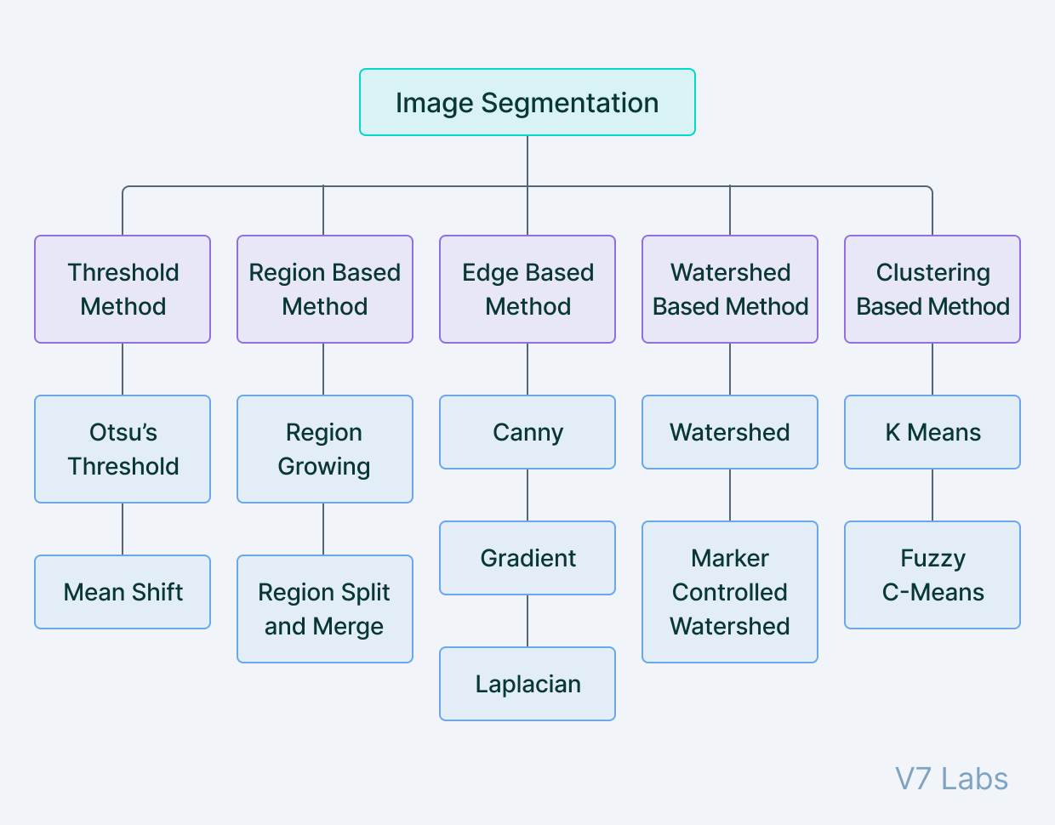
Image Segmentation Techniques: Traditional Techniques

Slide 16
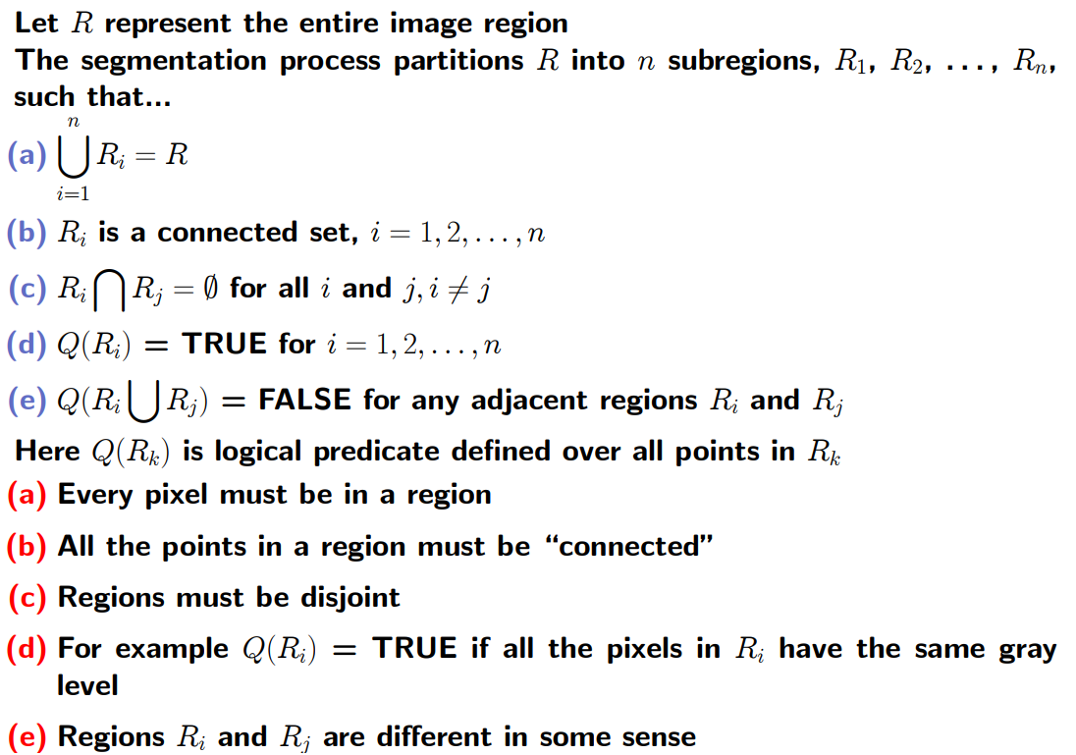
Segmentation Fundamentals

Slide 17
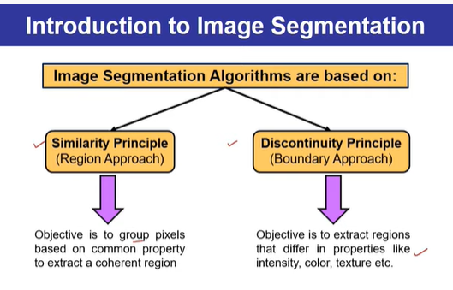
Principal approaches
Two basic properties of intensity values.
1. Discontinuity: To partition an image based on sharp changes in intensity (such as edges).
2. Similarity: To partition an image into regions that are similar according to a set of predefined criteria. Ex: Thresholding, region growing, and region splitting and merging.

Slide 18
Edge-based Segmentation Point Line Edge

Slide 19
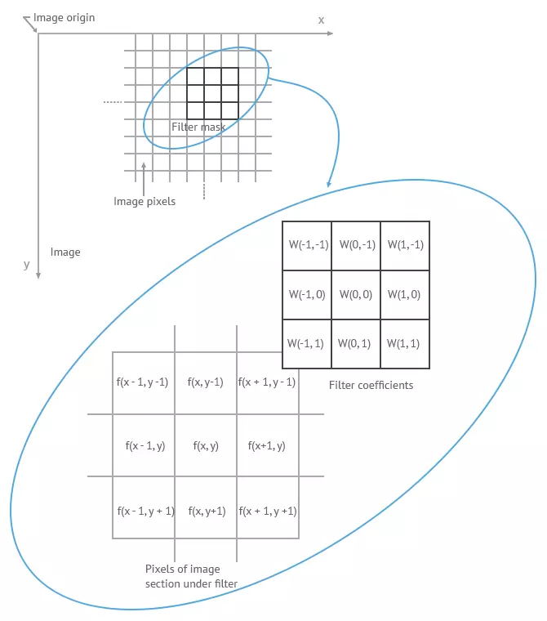
Convolution

Slide 20
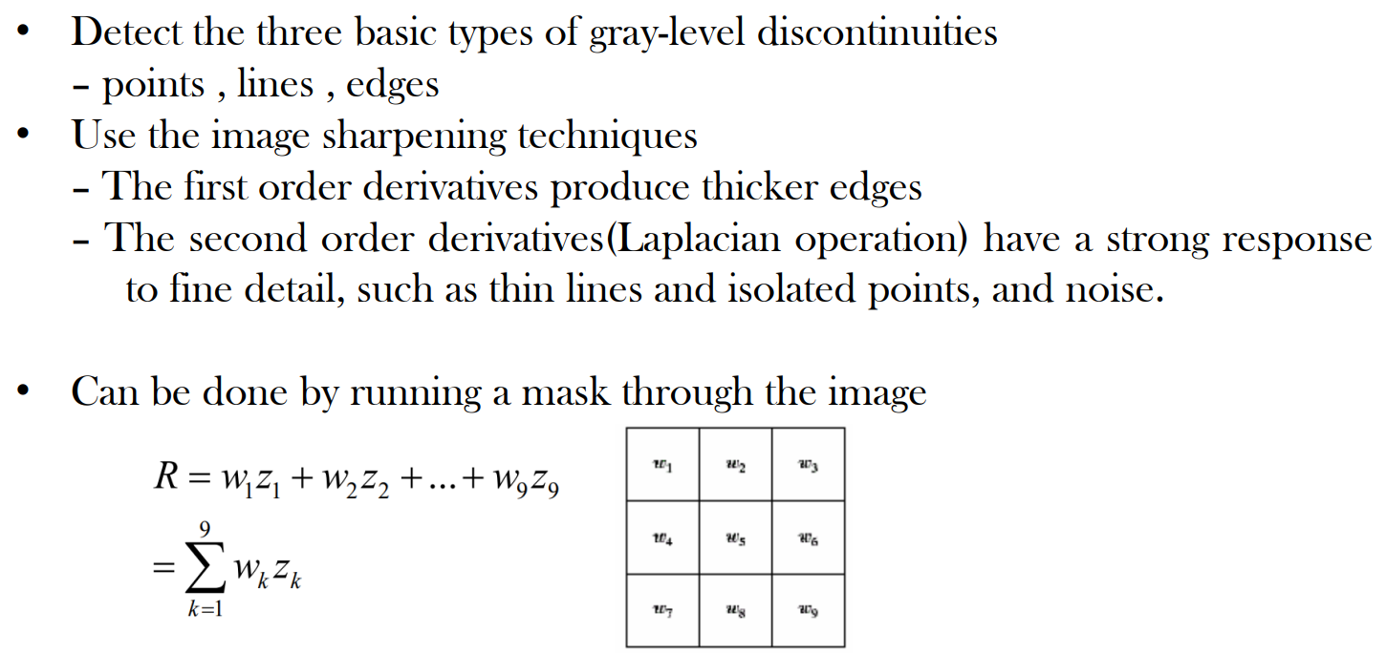
Detection of Discontinuities

Slide 21
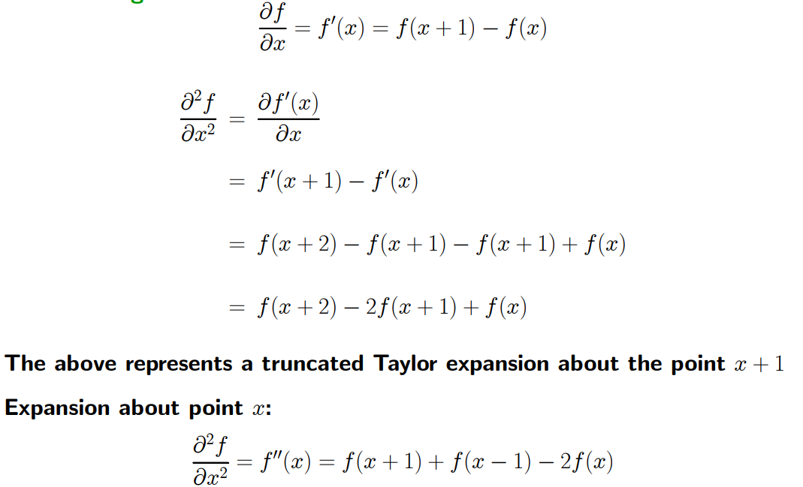
Detection of Discontinuities-Point, Line, Edge
First Derivative:
Second Derivative:

Slide 22
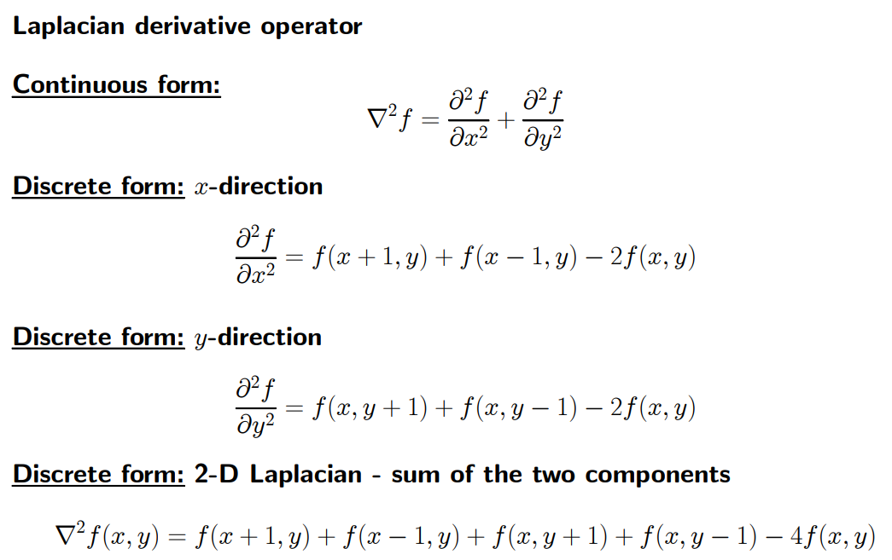
Detection of isolated points
We know that point detection can be done by using second derivative(Laplacian).

Slide 23
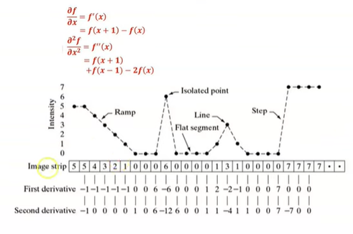
Properties of First Order and Second order derivatives

Slide 24
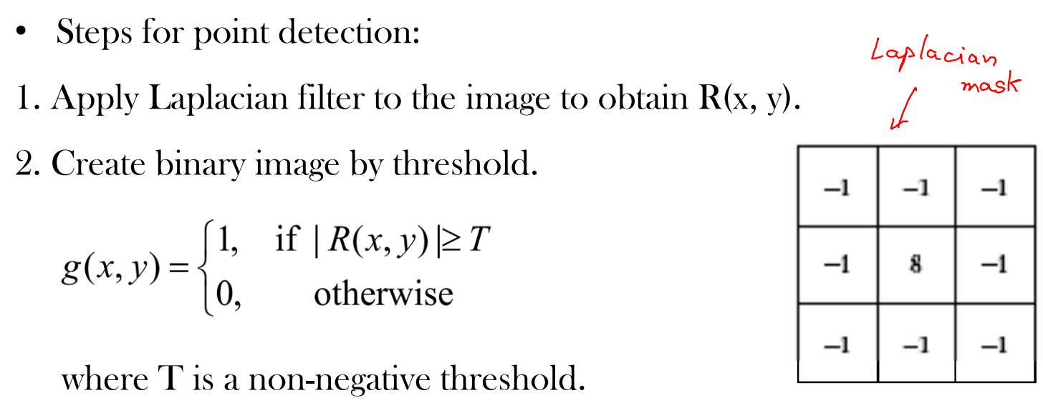
Detection of points

Slide 25
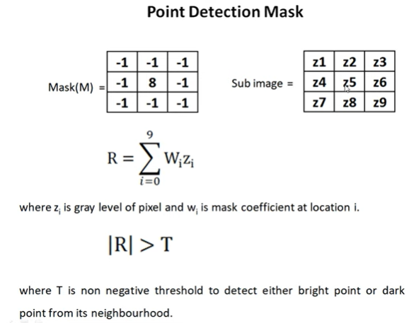
Example: Point Detection

Slide 26
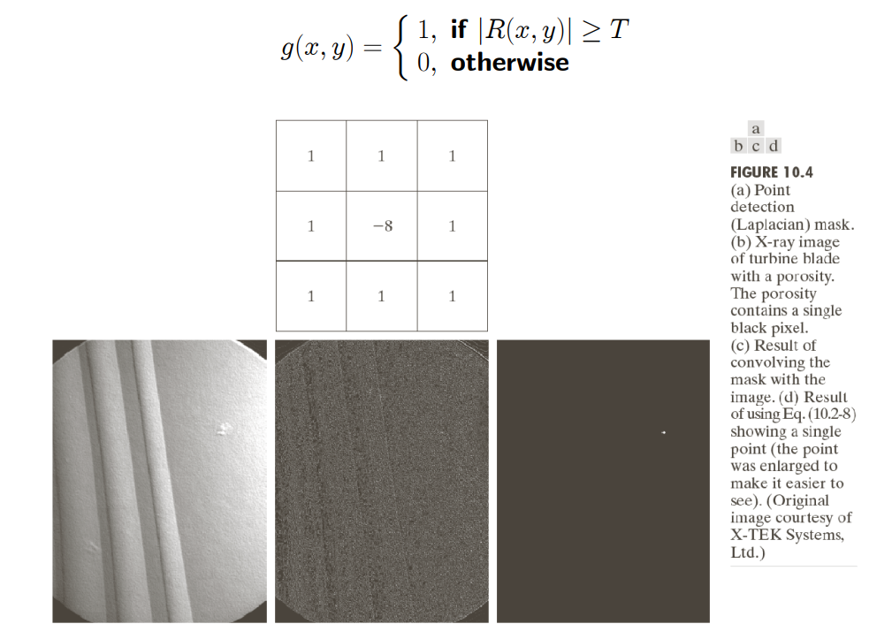
The output is obtained using the following expression:

Slide 27
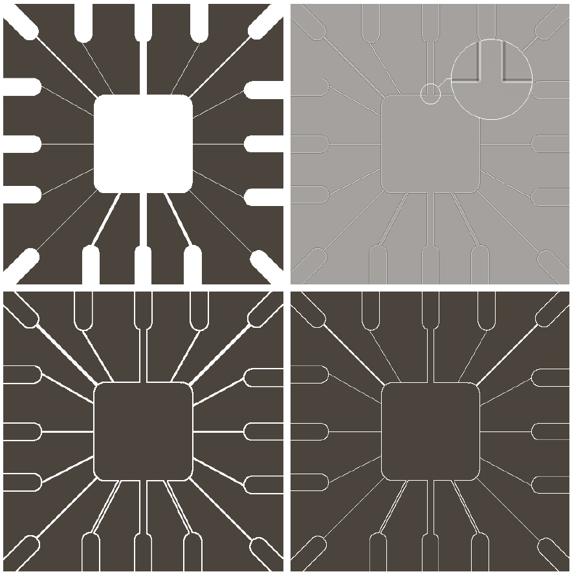
Line Detection-Laplacian filter
Second order derivative produces a stronger response to lines and produce thinner lines compared to first order derivative. Hence Laplacian is also used for detecting lines.
Absolute value doubles the thickness of lines

Slide 28
Detection of Lines-Laplacian filter
In line detection, the assumption is that lines are thin with respect to the size of the detector.
The Laplacian detector in Fig. 10.4(a) is isotropic, so its response is independent of direction (with respect to the four directions of the 3 X 3 Laplacian mask: vertical, horizontal, and two diagonals).

Slide 29
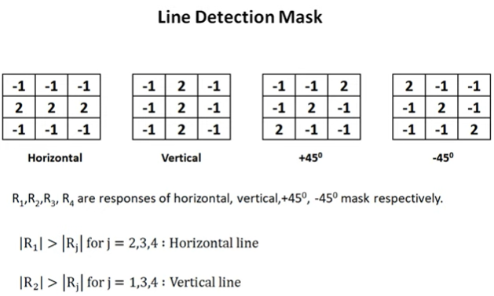
Example: Line detection

Slide 30
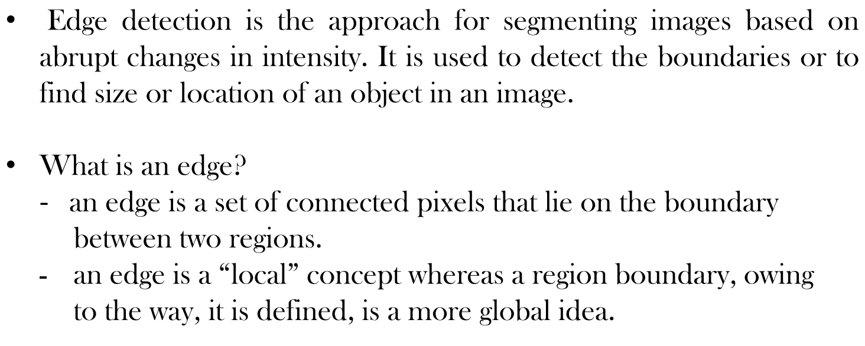
Detection of Edges

Slide 31
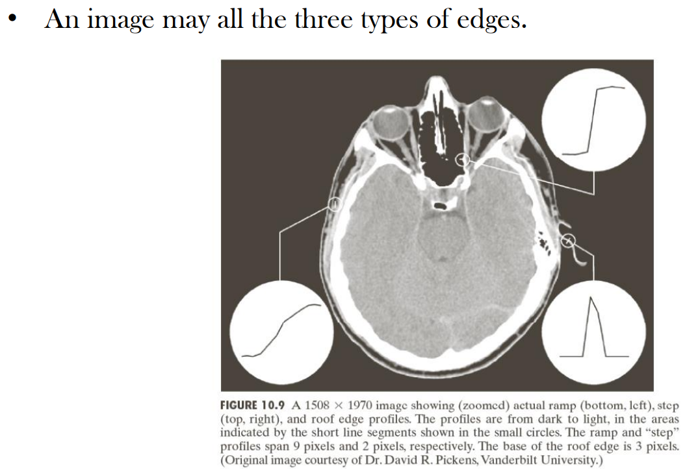
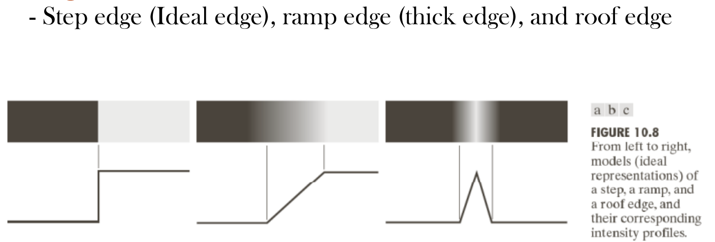
Edge Models

Slide 32
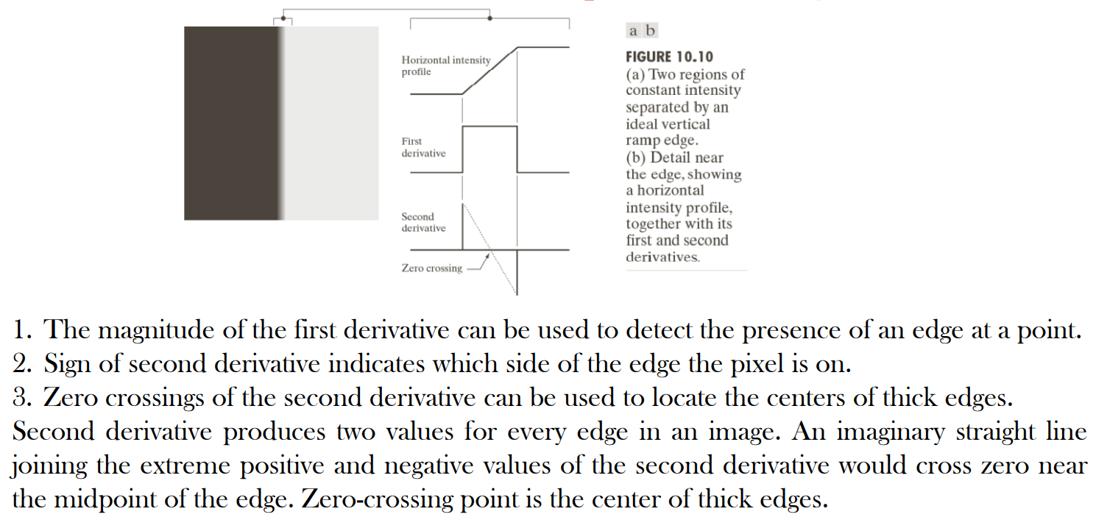
First and Second order derivatives response at the edge

Slide 33
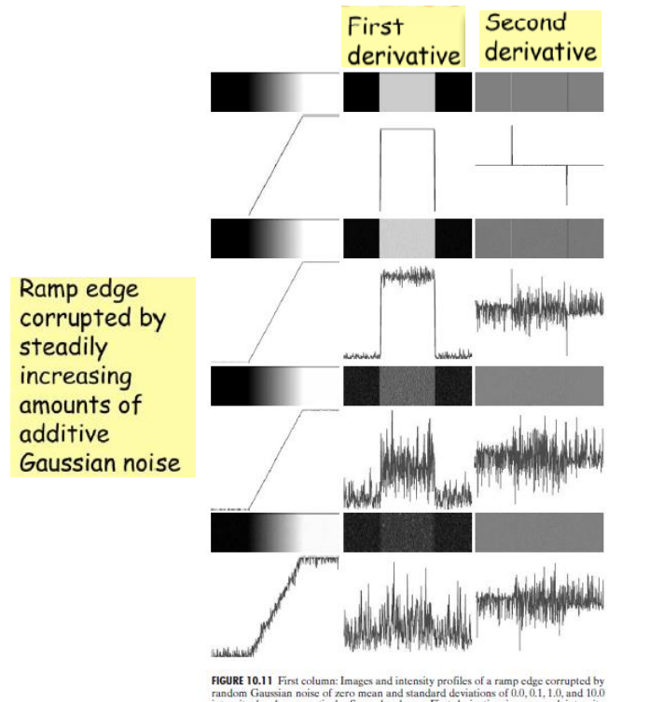
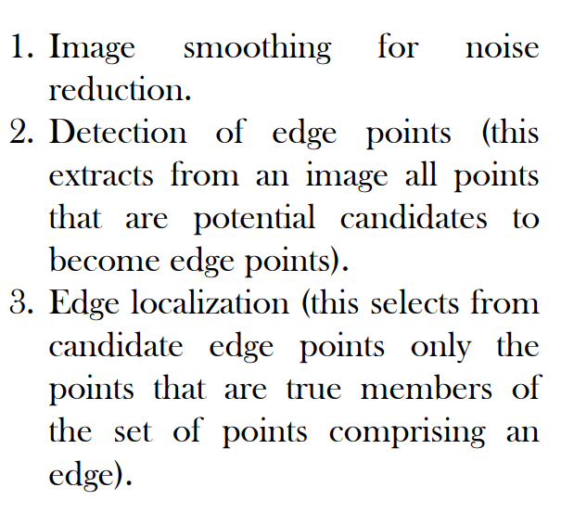
Fundamental steps performed in edge detection

Slide 34
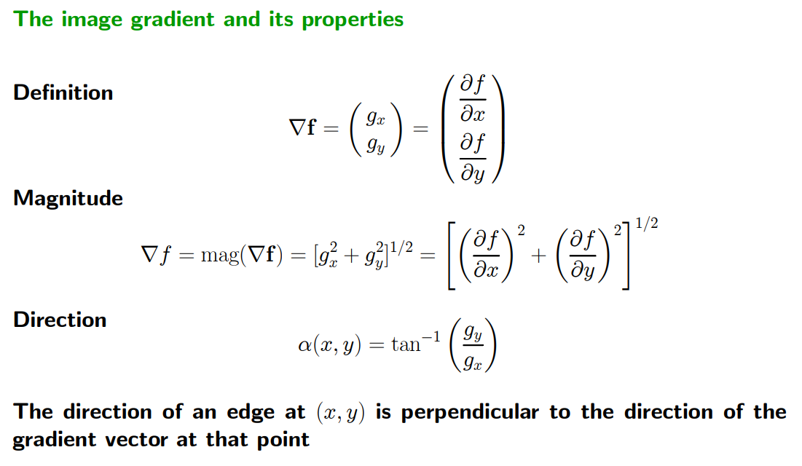
Image gradient in First order Derivative

Slide 35
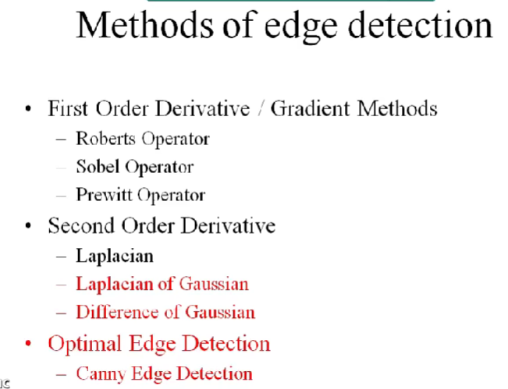

Slide 36
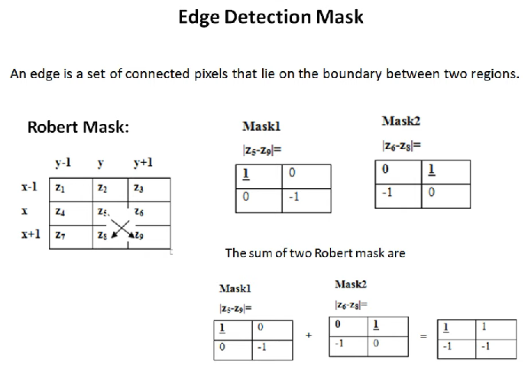
Basic Edge Detection-First order derivative

Slide 37

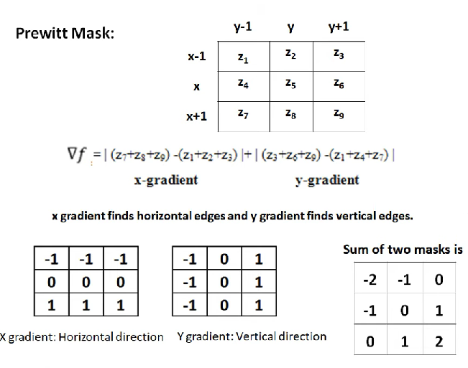

Slide 38
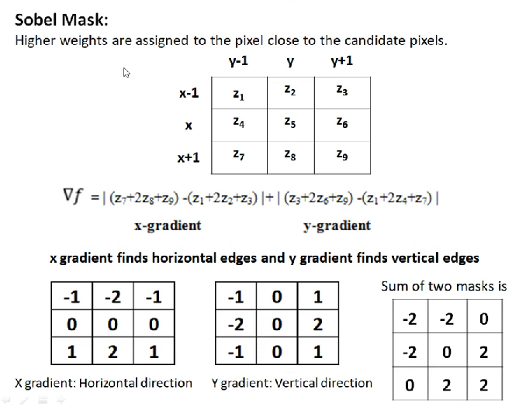
Basic Edge Detection-First order derivative

Slide 39
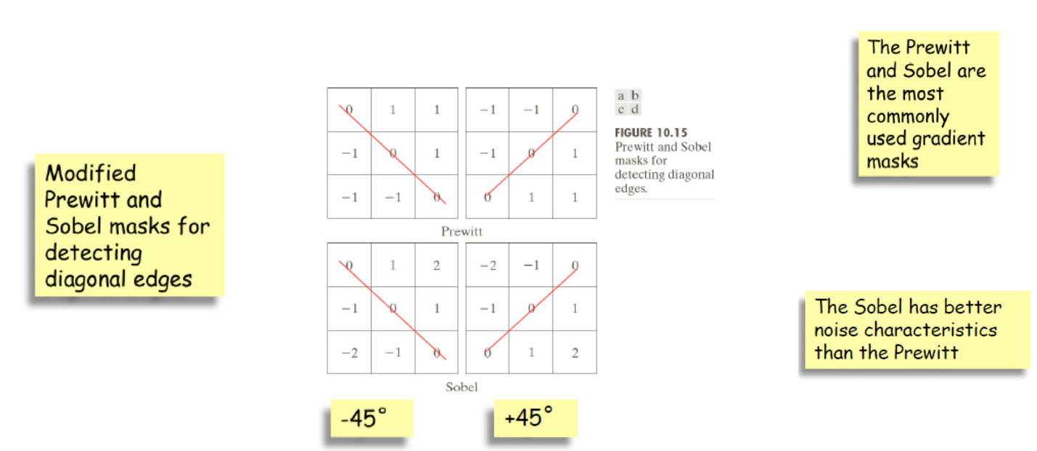
Mask for detecting diagonal edges

Slide 40
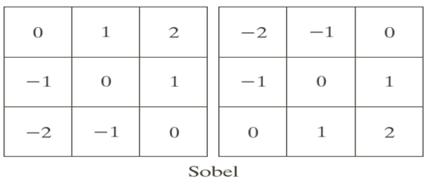

Slide 41
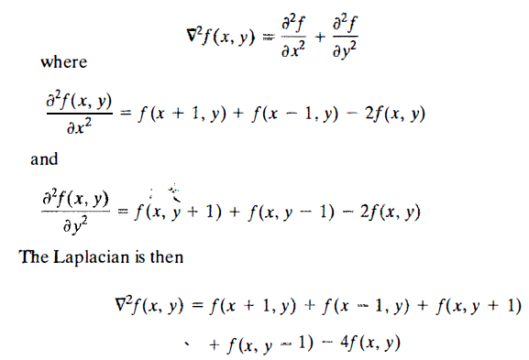
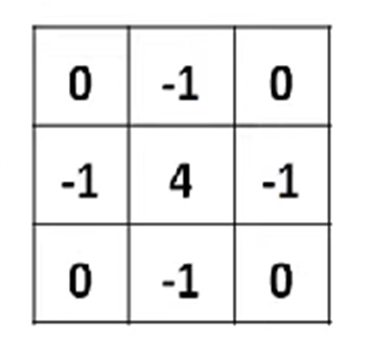
Edge Detection-Second order derivative-Laplacian
We know that point detection can be done by using second derivative(Laplacian).
This expression can be implemented using the masks.

Slide 42
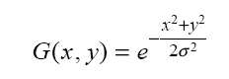
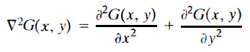
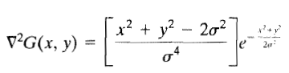
Advanced Edge detection by using Laplacian of Gaussian(LoG) or Marr-Hildreth edge detector
To reduce the noise effect, the image is first smoothed.
When the filter chosen is a Gaussian, we call it the LoG (Laplacian of Gaussian)edge detector.
Let G is the 2-D Gaussian function then
Where σ is standard deviation which
controls smoothing
Now
This expression is called the Laplacian of a Gaussian (LoG ).Because of the shape ,the LoG function sometimes is called the Mexican hat operator.

Slide 43
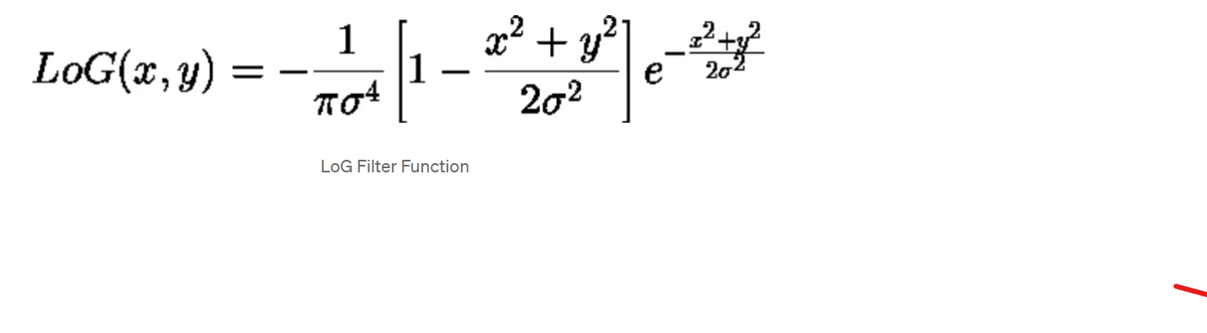
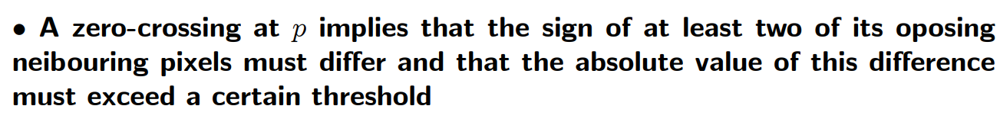
The Marr-Hildreth algorithm consists of convolving the LoG filter with an input image, f(x, y),
and then finding the zero crossings of g(x, y) to determine the locations of edges in f(x, y).
The Marr-Hildreth edge-detection algorithm :
Filter the input image with an n x n Gaussian lowpass filter.
Compute the Laplacian of the image resulting from Step 1.
Find the zero crossings of the image from Step 2.

Slide 44
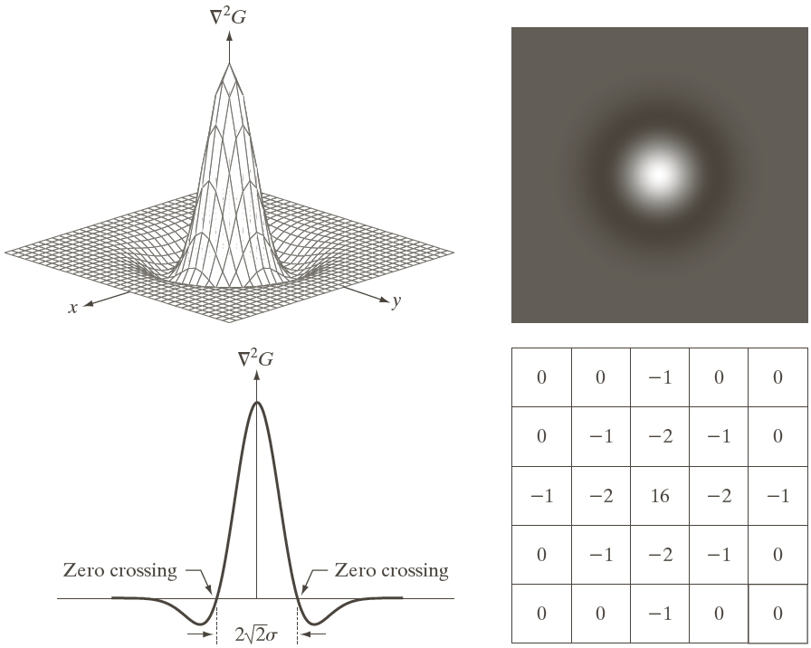
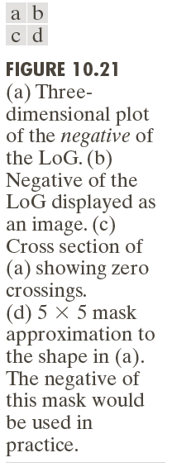

Slide 45
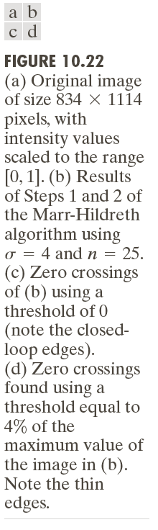

Slide 46
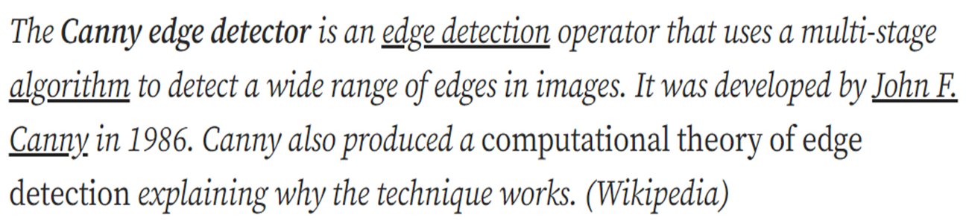
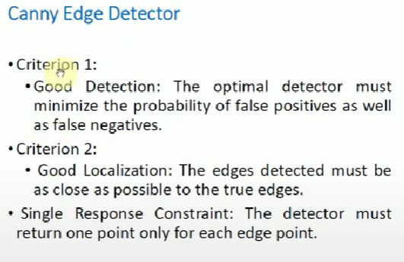
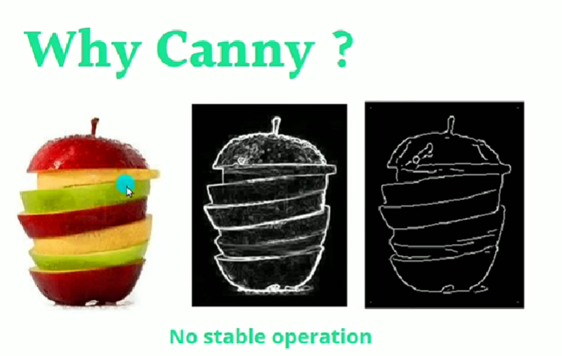
Canny Filter for Edge detection
***This Algorithm works on Gray scale images

Slide 47
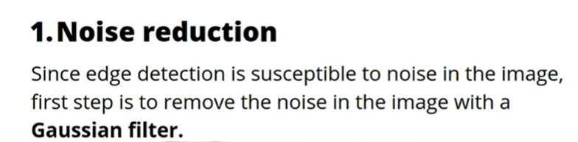
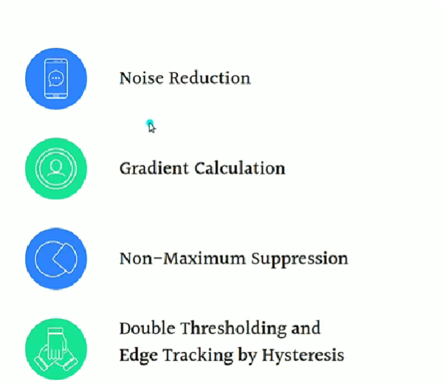


Procedure for Canny filters

Slide 48





Slide 49


Slide 50



Slide 51



Slide 52




Slide 53




Slide 54


Slide 55


Slide 56


Slide 57




Slide 58


Slide 59



Slide 60


Problems

Slide 61





Slide 62


Slide 63




Slide 64




Slide 65



Slide 66




Slide 67
Edge Linking and Boundary Detection
Edge detection typically is followed by linking algorithms designed to assemble edge pixels into meaningful edges and/or region boundaries
Three approaches to edge linking
Local processing
Regional processing
Global processing

Slide 68
Local Processing
Analyze the characteristics of pixels in a small neighborhood about every point (x,y) that has been declared an edge point
All points that similar according to predefined criteria are linked, forming an edge of pixels.
Establishing similarity: (1) the strength (magnitude) and (2) the direction of the gradient vector.
A pixel with coordinates (s,t) in S_{xy} is linked to the pixel at (x,y) if both magnitude and direction criteria are satisfied.

Slide 69

Local Processing

Slide 70


Slide 71

Region processing ( Polygonization)

Slide 72
Global Processing Using the Hough Transform
“The Hough transform is a general technique for identifying the locations and orientations of certain types of features in a digital image. Developed by Paul Hough in 1962 and patented by IBM,
The transform consists of parameterizing a description of a feature at any given location in the original image’s space. A mesh in the space defined by these parameter is then generated, and at each mesh point a value is accumulated, indicating how well an object generated by the parameters defined at that point fits the given image.
Mesh points that accumulate relatively larger values then describe features that may be projected back onto the image, fitting to some degree the features actually present in the image.”

Slide 73



Hough Transform (transform image plane to parameter space)

Slide 74


Slide 75




Slide 78
Edge-linking Based on the Hough Transform
Obtain a binary edge image
Specify subdivisions in
Examine the counts of the accumulator cells for high pixel concentrations
Examine the relationship between pixels in chosen cell

Slide 79


Slide 80


Slide 81



Slide 82
Thresholding

Slide 83

Thresholding
Thresholding is one of the simplest image segmentation methods. Here, the pixels are divided into classes based on their histogram intensity which is relative to a fixed value or threshold.
This method is suitable for segmenting objects where the difference in pixel values between the two target classes is significant.
In low-noise images, the threshold value can be kept constant, but with images with noise, dynamic thresholding performs better.
In thresholding-based segmentation, the greyscale image is divided into two segments based on their relationship to the threshold value, producing binary images.
Algorithms like contour detection and identification work on these binarized images.

Slide 84

The two commonly used thresholding methods :
Global thresholding is a technique used in image segmentation to divide images into foreground and background regions based on pixel intensity values.
This method is simple and efficient but may not work well for images with varying illumination or contrast. In those cases, adaptive thresholding techniques may be more appropriate.
Adaptive thresholding is a technique used in image segmentation to divide an image into foreground and background regions by adjusting the threshold value locally based on the image characteristics.
The method involves selecting a threshold value for each smaller region or block, based on the statistics of the pixel values within that block.
Adaptive thresholding is useful for images with non-uniform illumination or varying contrast and is commonly used in document scanning, image binarization, and image segmentation.
The choice of adaptive thresholding technique depends on the specific application requirements and image characteristics.

Slide 85

Thresholding

Slide 86


Slide 87

Basic Thresholding

Slide 88


Slide 89

Optimal Global Thresholding using Otsu’s method

Slide 90


Slide 91


Slide 92


Slide 93


Otsu Thresholding Numerical problem:
The algorithm will be demonstrated using the simple 6x6 image shown below. The histogram for the image is shown next to it. To simplify the explanation, only 6 greyscale levels are used.

Slide 94



Slide 95


Slide 96
Region based segmentation
(i) Region Growing
(ii) Region splitting and merging

Slide 97

Region growing

Slide 98

Region growing

Slide 99

Example –Region growing
In case of a region growing, the preferred rule can be set as a threshold.
For example: Consider a seed pixel of 2 in the given image and a threshold value of 3, if a pixel has a value greater than 3 then it will be considered inside the seed pixel region. Otherwise, it will be considered in another region.
Hence 2 regions are formed in the following image based on a threshold value of 3.
Condition : 8-Connectivity, absolute difference of pixel <=3

Slide 100


Example –Region growing

Slide 101

Example –Region growing

Slide 102

Example –Region growing

Slide 103

Example –Region growing

Slide 104

Example –Region Splitting
Region splitting is a top-down approach.
It begins with a whole image and divides it up such that the segregated parts are more homogenous than the whole.
Splitting alone is insufficient for reasonable segmentation, as it severely limits the shapes of segments. Hence, a merging phase after the splitting phase is always desirable, which is termed as the split-and-merge algorithm
Region Splitting and Merging
Region splitting and merging is an image-segmentation technique that takes spatial information into consideration. The region-splitting-and-merging method is as follows
Splitting:
The final partition is likely to contain adjacent regions with identical properties.
This drawback may be fixed by applying merging, and merging only adjacent regions whose combined pixels satisfy the predicate P.

Slide 105



Example –Region Merging

Slide 106

Example –Region Merging

Slide 107




Example- Split and merging

Slide 108





Slide 109


Slide 110
Segmentation by Morphological Watersheds

Slide 111
Segmentation by Morphological Watersheds
The concept of watersheds is based on visualizing an image in three dimensions: two spatial coordinates versus gray levels.
In such a topographic interpretation, we consider three types of points:
(a) points belonging to a regional minimum
-- (b) points at which a drop of water would fall to a single minimum (The catchment basin or watershed of that minimum) .
-- (c) points at which water would be equally likely to fall to more than one such minimum(The divide lines or watershed lines) .
The principal objective of segmentation algorithms based on these concepts is to find the watershed lines.

Slide 112


Slide 113
The idea is simple:
▪Suppose that a hole is punched in each regional minimum and that the entire topography is flooded from below by letting water rise through the holes at a uniform rate.
▪When rising water in distinct catchment basins is about the merge, a dam is built to prevent merging. These dam boundaries correspond to the watershed lines.

Slide 114

Illustration
Objective: finding the watershed lines.
In topographic view. in which the height of the "mountains’’ is proportional to gray-level values in the input image.
we imagine the perimeter of the entire topography (image) being enclose d by dams of height greater than the highest possible mountain, whose value is determined by the highest possible gray- level value in the input image.
Construction of dam to prevent catchment basins from merging.
Catchment basins
Watershed lines
Original image
Topographic view

Slide 116


Slide 117

(con’d)
Punch a hole in each regional minimal for water to fill up the catchment basin.

Slide 118

(con’d)
Water start merging, so shorter dam constructed
Longer dam constructed
Final result

Slide 119
One of the principal applications of watershed segmentation is in the extraction of nearly uniform objects from the background. Regions characterized by small variations in gray levels have small gradient values.
Thus in practice, we often see watershed segmentation applied to the gradient of an image, rather than to the image itself.

Slide 120
Watershed Segmentation Algorithm--
Starting with the notation:
g(x,y) is the image with min and max the lowest and highest graylevel, respectively
M₁, M₂, … M_{R} be the regional minima
T[n]={ (s,t) | g(s,t)<n }
C_{n}(M_{i}) is the set of (s,t) in the catchment basin of M_{i} that are flooded at stage n.
C[n-1] is a subset of C[n] and C[n] is subset of T[n]. So it implies that
Each connected component (CC) of C[n-1] is contained in exactly one CC of T[n].

Slide 121
Flooding
Initialization: C[min+1]=T[min+1]
Obtain C[n] from C[n-1] (recursively):
Let Q be the set of CC in T[n], and
3 possibilities for :
(a) empty
(b) containing one CC of C[n-1]
(c) containing more than one CC of C[n-1]

Slide 122
Constructing C[n]
Scenario (a) [empty]: a new minimum is found
q is incorporated into C[n-1] to form C[n]
Scenario (b) [containing 1 CC]: q lies in the catchment basin of some regional minimum
q is incorporated into C[n-1] to form C[n]
Scenario (c) [containing 1+ CC], part of the watershed line is encountered.
A dam must be build within q to prevent overflow between the catchment basins.

Slide 123

Dam Construction of height max+1
In C[n-1]
q
Scenario (c)

Slide 124


(con’d)
Dilate each CC of by the structuring element B,
subject to 2 conditions:
Dilation constrained to q (origin of B located in q)
Dilation cannot cause merging of CC’s being dilated
Change the height to max+1
B

Slide 125

Example
Gradient image
Segmented image

Slide 126
Image Segmentation Using ML

Slide 127
K-Means Clustering
It can group pixels with similar characteristics into clusters or segments.
This can be achieved using various clustering algorithms, such as K means clustering, mean shift clustering, hierarchical clustering, and fuzzy clustering.
K-means clustering
the pixels in an image are treated as data points, and the algorithm partitions these data points into K clusters based on their similarity.
The similarity is measured using a distance metric, such as Euclidean distance or Mahalanobis distance.
The algorithm starts by randomly selecting K initial centroids.

Slide 128

Mean shift clustering
In this approach, each pixel is represented as a point in a high-dimensional space, and the algorithm shifts each point toward the direction of the local density maximum.
This process is repeated until convergence, where each pixel is assigned to a cluster based on the nearest local density maximum.

Slide 129
Image Segmentation Using Deep Learning

Slide 130

NN Model
Neural networks also provide solutions for image segmentation by training neural networks to identify which features are important in an image, rather than relying on customized functions like in traditional algorithms.
Neural nets that perform the task of segmentation typically use an encoder-decoder structure. The encoder extracts features of an image through narrower and deeper filters.
If the encoder is pre-trained on a task like an image or face recognition, it then uses that knowledge to extract features for segmentation (transfer learning).
The decoder then over a series of layers inflates the encoder’s output into a segmentation mask resembling the pixel resolution of the input image.

Slide 131

Basic FCNN architecture for Segmentation
In the segmentation stage, CNNs are used to extract features from the region of interest (ROI) defined by the bounding box. The ROI is then fed into a fully convolutional network (FCN) to perform instance segmentation. The FCN consists of a series of convolutional and pooling layers followed by an upsampling layer to recover the original image size. The output of the FCN is a binary mask that identifies the pixels belonging to the object of interest.

Slide 132

U-Net
U-Net is a modified, fully convolutional neural network. It was primarily proposed for medical purposes, i.e., to detect tumors in the lungs and brain.
It has the same encoder and decoder. The encoder is used to extract features using a shortcut connection, unlike in fully convolutional networks, which extract features by upsampling.
The shortcut connection in the U-Net is designed to tackle the problem of information loss. In the U-Net architecture, the encoders and decoders are designed in such a manner that the network captures finer information and retains more information by concatenating high-level features with low-level ones. This allows the network to yield more accurate results.

Slide 133

DeepLab
DeepLab is primarily a convolutional neural network (CNN) architecture. Unlike the other two networks, it uses features from every convolutional block and then concatenates them to their deconvolutional block. The neural network uses the features from the last convolutional block and upsamples it like the fully convolutional network (FCN). It uses the atrous convolution or dilated convolution method for upsampling. The advantage of atrous convolution is that the computation cost is reduced while capturing more information.

Slide 134

Metrics for Evaluating Image Segmentation Algorithms
Pixel Accuracy
Pixel accuracy is a common evaluation metric used in image segmentation to measure the overall accuracy of the segmentation algorithm.

Slide 135

Metrics for Evaluating Image Segmentation Algorithms
Dice Coefficient
The dice coefficient measures the similarity between two sets of binary data, in this case, the ground truth segmentation and the predicted segmentation. The Dice coefficient ranges from 0 to 1, with higher values indicating better segmentation performance. A value of 1 indicates a perfect overlap between the ground truth and predicted segmentations.

Slide 136

Metrics for Evaluating Image Segmentation Algorithms
Jaccard Index (IOU)
The Jaccard index, also known as the intersection over union (IoU) score, measures the similarity between the ground truth segmentation and the predicted segmentation.
The IoU score ranges from 0 to 1, with higher values indicating better segmentation performance. A value of 1 indicates a perfect overlap between the ground truth and predicted segmentations.

Slide 137
Datasets for Evaluating Image Segmentation Algorithms
Barkley Segmentation Dataset and Benchmark
Pascal VOC Segmentation Dataset
MS COCO Segmentation Dataset

Slide 138
Future Direction of Image Segmentation
Incorporating additional data sources: One approach to improving segmentation accuracy is incorporating additional data sources beyond the raw image data. For example, depth information can provide valuable cues for object boundaries and segmentation, particularly in complex scenes with occlusions and clutter.
Developing new segmentation algorithms: Researchers continuously develop new algorithms for image segmentation that can improve accuracy. For example, some recent approaches use adversarial training or Reinforcement learning to refine segmentation results.

Slide 139
Improvement in segmentation accuracy
Improving segmentation accuracy is one of the main goals of researchers in the field of computer vision.
Improving annotation quality: The quality of the ground truth annotations used to train segmentation algorithms is essential to achieving high accuracy. Researchers are working to improve annotation quality through various means, including incorporating expert knowledge and utilizing crowdsourcing platforms.
Refining evaluation metrics: Evaluation metrics play a crucial role in measuring the accuracy of segmentation algorithms. Researchers are exploring new evaluation metrics beyond the traditional Dice coefficient and Jaccard index, such as the Boundary F1 score, which can better capture the quality of object boundaries.

Slide 140
Integrate Deep Learning with Traditional Techniques
Hybrid models: Researchers are developing hybrid models that combine deep learning with traditional techniques. For example, some approaches use clustering or thresholding to initialize deep learning models or post-process segmentation results.
Multi-stage approaches: Multi-stage approaches involve using deep learning for initial segmentation and then refining the results using traditional techniques. For example, some approaches use morphological operations to smooth and refine segmentation results.

Slide 141
Integrate Deep Learning with Traditional Techniques
Attention-based models: Attention-based models are a type of deep learning model that incorporates traditional techniques for computing attention weights within a feature map. Attention-based models can improve accuracy by focusing on relevant image features and ignoring irrelevant ones.
Transfer learning: Transfer learning involves pretraining deep learning models on large datasets and then fine-tuning them for specific segmentation tasks. Traditional techniques such as clustering or thresholding can be used to identify relevant features for transfer learning.

Slide 142
Any queries??

